Slide 1

Classify space rocks by using Python and artificial intelligence
Abhigya Verma Microsoft Learn Student Ambassador Alpha

Slide 2
Module 1: Learn about space rocks and how to classify them This learning path gives you a view into the worlds of AI and space. Learn how to create an AI model that can classify the type of space rock in a random photo..
Abhigya Verma Microsoft Learn Student Ambassador Alpha
Notes:
As technology advances, many disciplines outside the field of computer science have found ways to introduce advanced technologies into their work. Artificial intelligence (AI) is a relatively new technology that's being applied to many tasks.
This Microsoft Learn learning path is the second in a series of learning paths that highlight how AI might influence NASA research, and space exploration in general. From teaching a computer to detect which rock an astronaut should collect based on the rock type, to predicting whether a rocket can launch on a specific day, AI can be a useful tool for the brilliant research minds that are behind some of Earth's most inspiring discoveries.
The programming services and libraries that do much of the complex math and algorithms in AI are widely available. For example, Python libraries and packages like PyTorch explore, visualize, and analyze data. Azure also offers AI services that analyze an image by using a simple API call.
Although AI has complexities and levels we won't cover in the Learn modules, this learning path introduces you to some basic AI tools and services. In a later module, we'll use some of these tools and services to build an AI model.

Slide 3
Learning objectives
In this module, you'll learn:
Learn what space rocks are and why we study them
Learn about upcoming space missions that focus on space rocks

Slide 4
Prerequisites
The Role of Python in space exploration learning path
Visual Studio Code, with the Python extension

Slide 5
The scientific research of space rocks
Notes:
The application of AI that we focus on in this learning path is how to use a computer to classify space rocks. You might be wondering why we would want to study something as commonplace as a rock. The answer is there are many amazing things we can learn from and do with rocks that come from space.

Slide 6
What are space rocks?
Notes:
Before we jump into why we choose to study space rocks, let's first classify the different rocks and soil that NASA scientists study. Rocks and soil from space come in many sizes, ranging from tiny specs of soil found on the Moon to boulders the size of planets that float through space. Boulders that originate in space might be discovered flying through space as meteoroids and asteroids or found on the surface of moons, planets, and even Earth as meteorites.

Slide 7
Why are they important?
Notes:
When I first started to learn about space rocks, I thought, "Why does NASA keep sending rockets to the Moon to collect space rocks?" (Don't tell NASA I said that!) Now, I know that space rocks have many uses. In this module, we won't cover all the ways we can use space rocks because of the sheer volume. But for one, rocks tell us about the history of our Solar System as they record geological events like the eruption of a volcano. Space rocks have been here much longer than humans, and they'll be here long after we're gone.
An example of how we learn about the Solar System by studying space rocks is the rock type, granite. Granite is plentiful on Earth, but our research tells us that granite is rare everywhere else in the Solar System. We know that granite is formed in tectonic regions where mountains are formed. Many other planets and their moons don't have plate tectonics. This difference between Earth and other parts of the Solar System gives us background information about the current structure of other planets and how the planets were formed.
Along with learning about the history of the Solar System, space rocks can help us in our search to find signs of life or the ability to sustain life other than on Earth. Many rocks in the Universe are water-bearing. If we know a lot about these rocks, we can search for planets that have these rocks. One day, we might find life or an environment with water that can sustain human life.
A final example of what studying space rocks can do for us is that it can help prepare for the future. Although it might seem like a long way off, at some point, we might harvest space rocks as a resource like we gather wood from trees now. Many space rocks have gases and chemical compounds in them that are rare or potentially not found on Earth. In the future, we might use these resources to create new technology that's useful to people on Earth. We might use space rocks to further our exploration of the Solar System possibly by using them to develop rocket fuel.

Slide 8
Space rocks on planet Earth
Notes:
As we mentioned earlier, a prominent place to gather space rocks is actually on Earth. Astronauts on planned space missions try to collect specific types of space rock, including meteorites. On Earth, we're at the mercy of meteoroids that happen to crash onto the surface of our planet. After such an impact, we get the chance to explore the debris field in the hopes of finding our own meteorites.

Slide 9
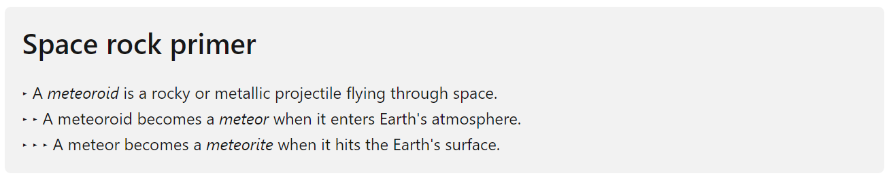
Notes:
Meteorites found on Earth are covered with a burnt fusion crust that's formed when the meteor travels through the Earth's atmosphere. The fusion crust that covers meteorites and space rocks makes it difficult to identify the type of rock until it's brought to the lab to be cleaned and analyzed.

Slide 10
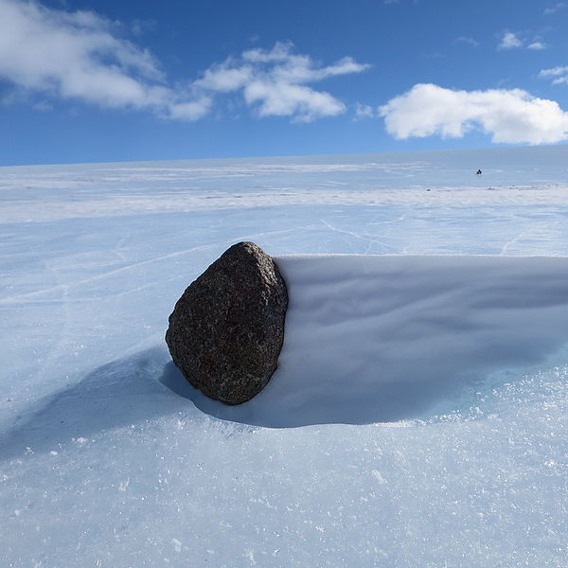
Where can we find space rocks on Earth?
Notes:
Although meteorites might be found anywhere on our planet, hot and cold deserts like those found in Northwest Africa and Antarctica are major spots for finding meteorites. Antarctica is a good location to search for meteorites because the black color of the fusion crust stands out against blue glacier ice. In other areas, meteorites might be obscured by vegetation, blend in with the ground, or look like other common rocks or debris in the area. Antarctica also offers a unique, constant, dry, and cold climate that helps preserve the organic chemicals in meteorites. In other areas, shifts in temperature and precipitation, along with the impact of humans in the area, make the rock sample less likely to be preserved over time. In meteorite research, a high degree of preservation gives us a clearer understanding of the rock's original composition.

Slide 11
The challenges of collecting space rocks
Notes:
If you thought the hard part about collecting space rocks is over after flying a rocket 238,855 miles to the Moon, you'd be mistaken. Even after astronauts or rovers land on the Moon, selecting rocks that are valuable to research becomes a serious challenge. With limited space on rockets to bring back samples, and with so many types of space rocks, choosing the ones to collect and which to leave behind is a difficult process.
You might think about the challenge this way:
If you could choose only one place on Earth to study to fully understand Earth, where would you go?
Such a place doesn't exist. So, you narrow the scope.
If you go to a specific region on Earth, like the Grand Canyon, which rocks would you collect for study to fully understand that region? It's still a challenging task. It's similar to the task that astronauts face when they choose rocks to collect on the Moon's surface.

Slide 12
How can AI help astronauts with space rocks?
Notes:
Astronauts complete a vast array of preparations before they go into space. Their top priority is a safe and successful journey to their destination. But one of the main goals of traveling to the Moon is to collect specimens so that we can better understand our Moon and our Solar System.
Have you ever walked along a beach looking for rocks that are pretty or unusual? You might spend a few hours looking, trying not to miss anything special, but you don't want to get on your hands and knees to examine each rock either. The surface of the Moon is fully covered with potential samples that an astronaut might collect and take back to Earth. And the types of rocks aren't easily identifiable with a glance.
On the Moon, basalt and highland are common types of rocks. Highland rock is the original crust of the Moon. Regolith is a layer of rock and soil that's been broken up by the impact of colliding objects. Another kind of rock found on the Moon is breccia, which is a combination of other rocks smashed together. So, the chemical composition of these rocks may be similar to the original rock types, but they might not be what the astronaut was instructed to collect.
Furthermore, the photos of rocks that you'll see in this learning path have already been cleaned. The photos were taken in a studio with good lighting and really close-up. Being able to identify these rocks on the surface of the Moon while wearing a space suit, without being able to touch the rock, and with less than ideal lighting, makes it even more of a challenge.
Here's a photo of basalt rock:

Slide 13
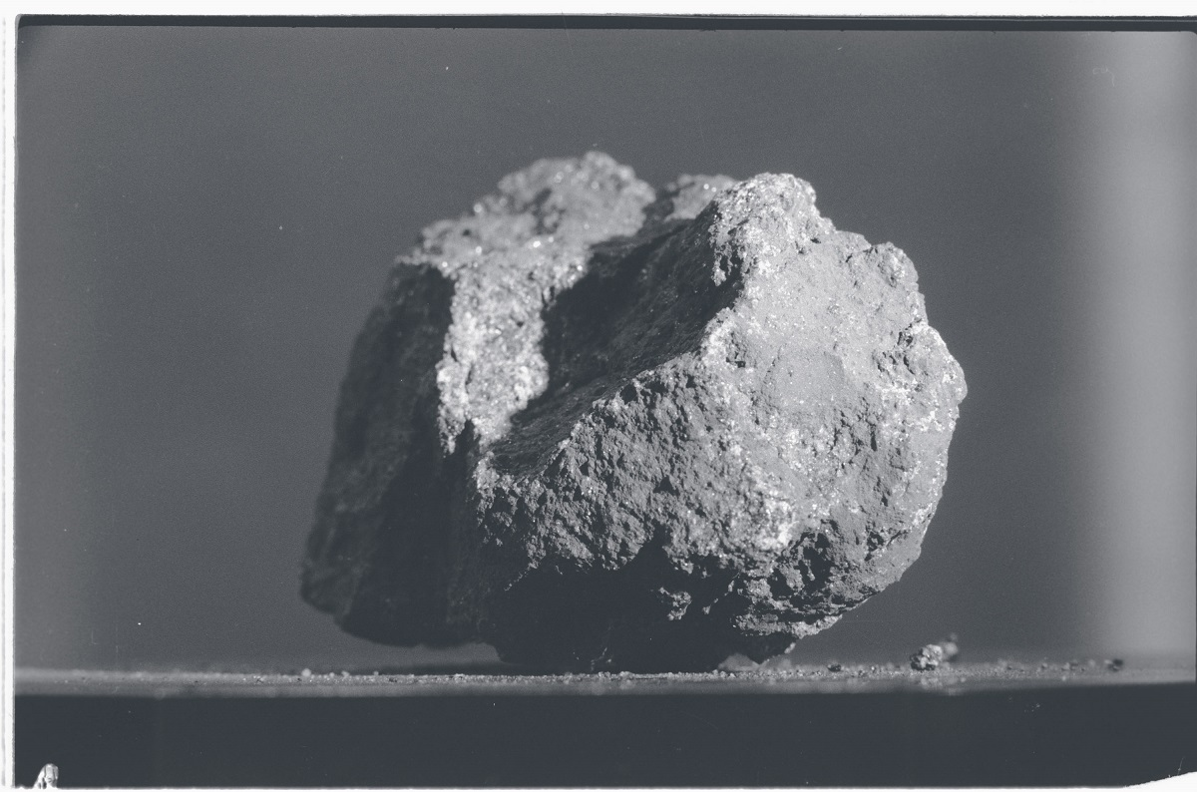

Slide 14
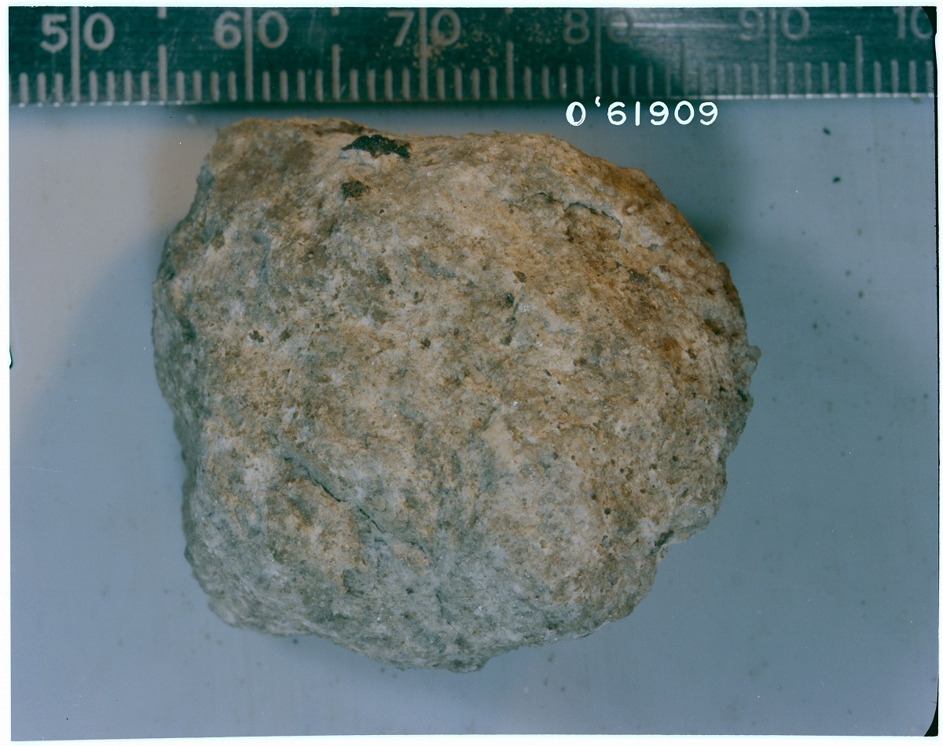
Notes:
Here's a photo of highland rock:

Slide 15
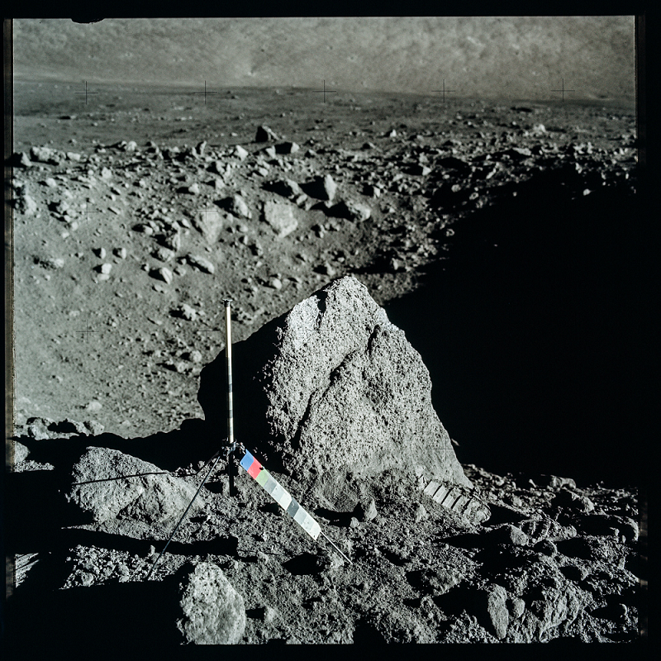
Notes:
Here's a photo of an area that an astronaut might survey for rocks:

Slide 16
Is being unique always a good thing?
Notes:
Another aspect of gathering space rocks that might be hard to conceptualize is the procedure for picking up rocks that look "different." If you see a white rock surrounded by all black rocks, a person's instinct is to pick up the white rock and ignore all the black rocks. However, collecting only this white rock wouldn't provide us with an understanding of the "average" rocks in the area, just the unique one. Therefore, astronauts are asked to also collect samples of the black rocks to get an accurate representation of the area. A common trick is to pick up 10 average rocks in the area, and then collect the rocks that look more unique.

Slide 17
What about Moon rovers?
Notes:
Having astronauts learn about rocks is one thing, but using rovers to pick up the correct rocks on the Moon is also difficult. Sending instructions to a rover so far away takes a long time, so many instructions have to be simple like move forward or turn right. Also, as you'll see in this learning path, having a computer accurately identify rocks on the ground is a challenge, when the rocks used to create the AI model were cleaned and professionally photographed. Rocks on the ground are covered with dirt and dust, the lighting might be poor, shadows are prevalent, and the surrounding landscape is covered with similar-looking material. Rocks on the ground on the Moon might not look like the rocks in photos of rocks in the lab, even if they're the same type of rock.

Slide 18
AI solutions for space rock research
Notes:
If we integrate AI into the process of analyzing space rocks, we can improve the collection process for both humans and rovers. We could send astronauts to the Moon armed with a computer that can take photos of rocks. The computer could show the astronaut the rock type. The astronaut could determine if that type of rock is needed in the collection and decide to pick it up or leave it. In a future mission, the computer could be placed in a rover that autonomously drives across the surface of the Moon and scans for rocks that we need for research.
By integrating AI, astronauts could more quickly and accurately locate and identify rocks they should bring back to Earth. The computer could collect metadata like location, temperature, and light exposure. With accuracy feedback from astronauts and scientists on Earth, the AI model used to identify valuable rocks would improve over time.

Slide 19
How can AI help research on Earth?
Notes:
As we mentioned earlier, AI works better when the sample data is cleaner. We see improved performance for multiple scenarios involving space rocks:
When the rocks are physically clean
When the photos of the rocks have similar lighting, so the visual coloring of the rock is consistent
When the edges between the rock and the background are clean and consistent
When each photo of a rock has a clear indication of scale
An AI model that can help identify, classify, and track these rock samples would provide clear instructions about how to take the photos to fit the current model. When we have an AI model that fits these criteria, lunar rock curation and research can move toward answering even more nuanced research questions. We might even consider using a rover and AI on Earth to collect meteorites in Antarctica.

Slide 20
How can AI help with research in space?
Notes:
AI and image quality might not be good enough yet to take a satellite picture of a planet's surface and give an overview of the types of rocks that are on it. But, we can start to understand where AI can help and where it's limited.

Slide 21
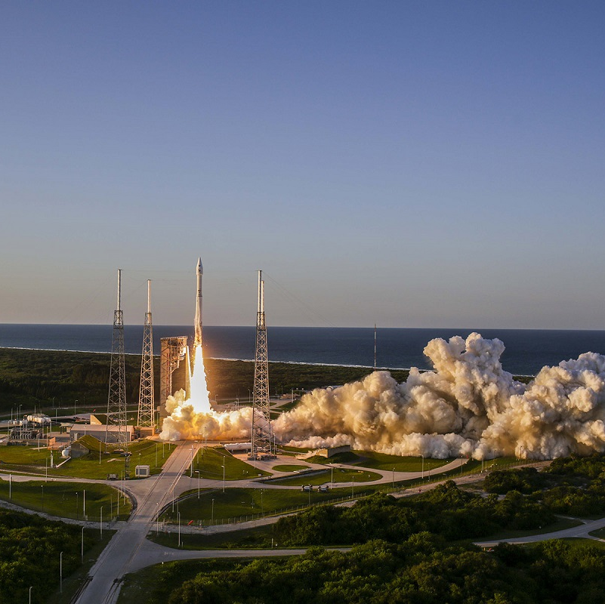
NASA mission: Study space rocks
Notes:
Many space missions have taken astronauts and rovers into space to search for space rocks. One of these missions is the NASA OSIRIS-REx mission.

Slide 22
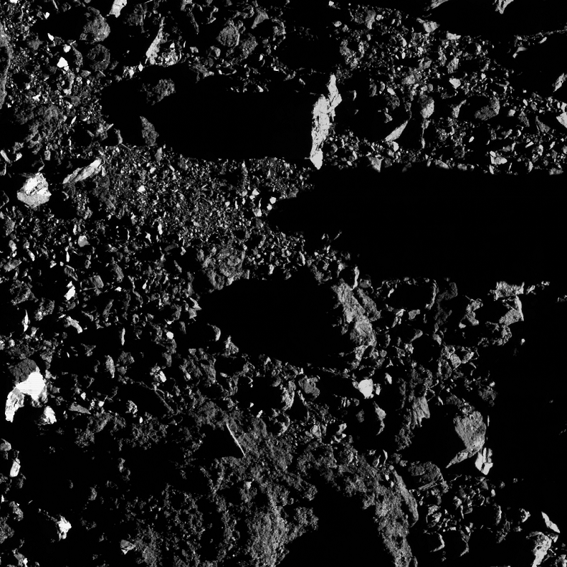
Notes:
The OSIRIS-REx mission includes launching a space craft into orbit and gathering samples from an asteroid named Bennu. The regolith space rock of the asteroid might record the earliest history of our Solar System. The OSIRIS-Rex mission is all about finding out more about where humans came from and what our destiny is. The OSIRIS-REx mission is unique compared to the other types of missions that we've talked about. The OSIRIS-REx takes high-quality photos while in orbit and also lands to gather samples. The photos are sent to rock experts on Earth, who analyze features of the photos to gain information about our Solar System.

Slide 23

QUIZ TIME!!!
https://forms.office.com/r/YEETkpyHzt
Notes:
In this lesson, you learned about different types of space rocks and some of the forms they can take.
A meteoroid flying through space becomes a meteor when it enters Earth's atmosphere.
A meteor becomes a meteorite when it hits the Earth's surface.
Fun fact: Meteorite rocks are found on Earth and in space!
Hot and cold deserts like those found in Northwest Africa and Antarctica are good spots for finding meteorites.
Astronauts have some challenges to overcome when gathering space rocks for their research, but solutions are available. AI is one of the solutions and the technology is improving every day.
The NASA OSIRIS-REx mission gathers regolith space rock samples from the asteroid Bennu. The mission equipment captures high-quality photos while in orbit. The photos are sent to rock experts on Earth, who analyze features of the photos to gain information about our Solar System.

Slide 24
THANK YOU SO MUCH!!!
Notes:
In this lesson, you learned about different types of space rocks and some of the forms they can take.
A meteoroid flying through space becomes a meteor when it enters Earth's atmosphere.
A meteor becomes a meteorite when it hits the Earth's surface.
Fun fact: Meteorite rocks are found on Earth and in space!
Hot and cold deserts like those found in Northwest Africa and Antarctica are good spots for finding meteorites.
Astronauts have some challenges to overcome when gathering space rocks for their research, but solutions are available. AI is one of the solutions and the technology is improving every day.
The NASA OSIRIS-REx mission gathers regolith space rock samples from the asteroid Bennu. The mission equipment captures high-quality photos while in orbit. The photos are sent to rock experts on Earth, who analyze features of the photos to gain information about our Solar System.

